Slide 1


Price Forecasting Model For EdTech Course

Slide 2

Project Leadership
Sharat Manikonda
Director at Innodatatics and Sponsor
linkedin.com/in/sharat-chandra

Slide 3
Team Members
Name: Surya dewangan
https://www.linkedin.com/profilelink
Name: Sarfaraz
https://www.linkedin.com/profilelink
Name:Rahul Gupta
https://www.linkedin.com/profilelink

Slide 4

Contents
What is Project Overview and scope?
Project Goals - Objective and Constraints of Project.
CRISP-ML Methodology, Technical Stacks, Project Architecture.
Data Creation (mockaroo.com).
Data Customization.
Data Preprocessing - Exploratory Data Analysis and Data visualization.
Model Selection(Pycaret).
Model Building.
Output insights.
Conclusion.
Deployment.
Notes:
Change

Slide 5
Project Overview and Scope
A Blume Ventures report said that the edtech market was close to $750 mn in 2020 and will hit $4 bn by 2025, a recent report by management consulting and market research firm Redseer puts that number at $5 billion by 2025.
So as the Edtech market is booming so are the challenges are also arising:
A major challenge in the early days of any EdTech startup is pricing. Without a constant flow of new signups allowing you to test different price points, or a clearly defined target customer group you could survey, it’s largely a shot in the dark.
So this Machine learning Model will help the Edtech Companies to smartly place the Prices of their course in this highly competitive market.

Slide 6


Project Goals
Objectives: Constraints:
To create a ml model which can accurately Finding the Accurate and reliable Historical data.
Predict the price of EdTech course which is
to be launched.

Slide 7
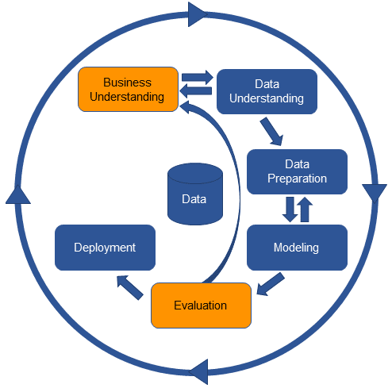
CRISP-ML(Q) Methodology

Slide 8








Technical Stacks
Notes:
Pycharm add Tableau

Slide 9
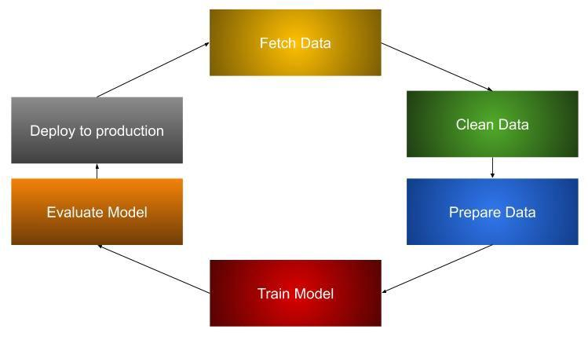



Project Architecture

Slide 10

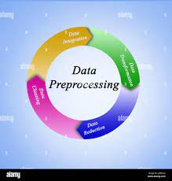
Data Collection and Understanding
DATA COLLECTION
Data is prepared with the help of the mockaroo website “https://www.mockaroo.com/”
Data created has 17 features with “Price” as the output variable.
Data is also customized in the mockaroo website to create some pattern in the data.
Data in generated after the close research on the features and in accordance values are assigned to it.
Generated data has 1000 rows and 17 features.
DATA PREPROCESSING
Data is being created in an organised manner and patterns are being created in the data on the mockaroo (“https://www.mockaroo.com/”) with the help of the customization matrix.
Exploratory data analysis (EDA) is done with the help of the pandas-profiling.
Unwanted columns are dropped with the help of python.
Dummies creation and one hot encoding were also necessary which were also taken care with the help of python.

Slide 11
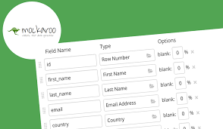
Data Information
Data created has 1000 rows and 17 columns.
Data is being created on the mockaroo website(https://www.mockaroo.com/).
Features are being selected after researching about the factors which are being responsible for pricing any edtech newly launched course.
Now after selecting the features my next aim was to create the dataset with the relevent values according to the features. So for researching that I took the help of google and various edtech platforms like 360digitmg,byju’s,scalar,upgrad etc.
Now after selecting the values I assigned them according to the features in the mockaroo website and then customized them using the customization matrix.
Features of the data are as follows:
course_title,course_type(online,offline),state,course_category(pg,skill_enhancement),infrastructure_cost,no_of_instructurs,course_duration(in hours),support_staff_required,cost_of_course_curriculam,cost_of_course_material,office_rent,daily_expenses,marketing_cost,placements,price.

Slide 12
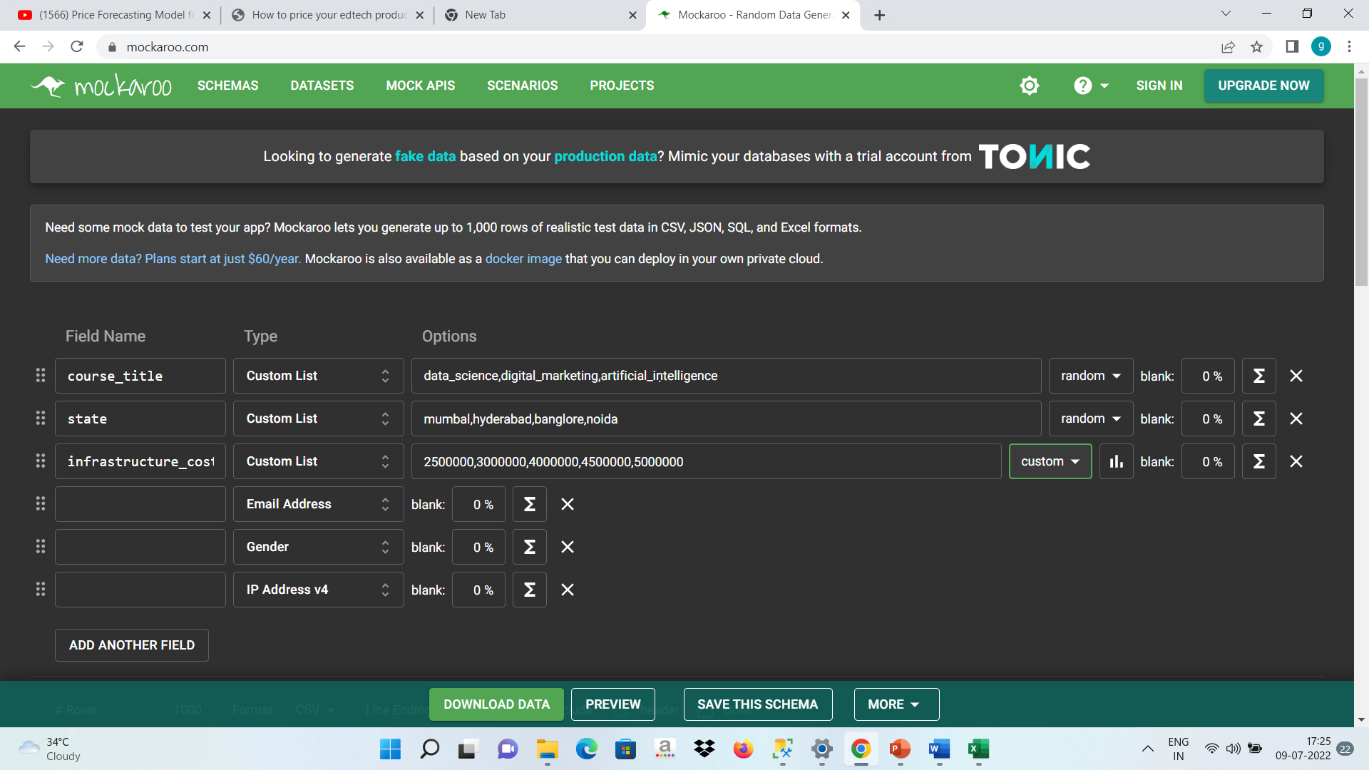
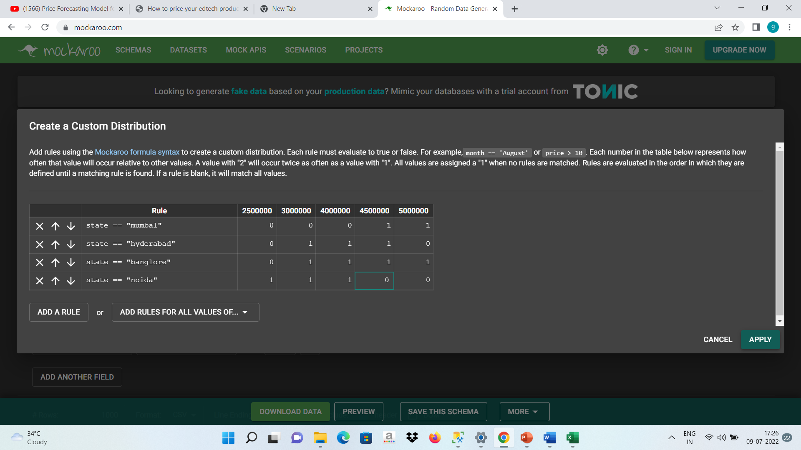
Data Dictionary

Slide 13
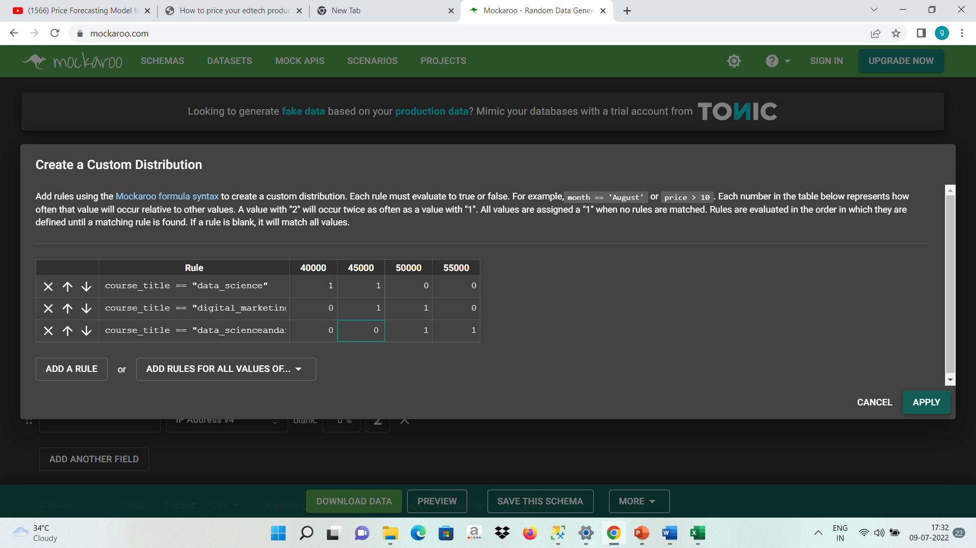
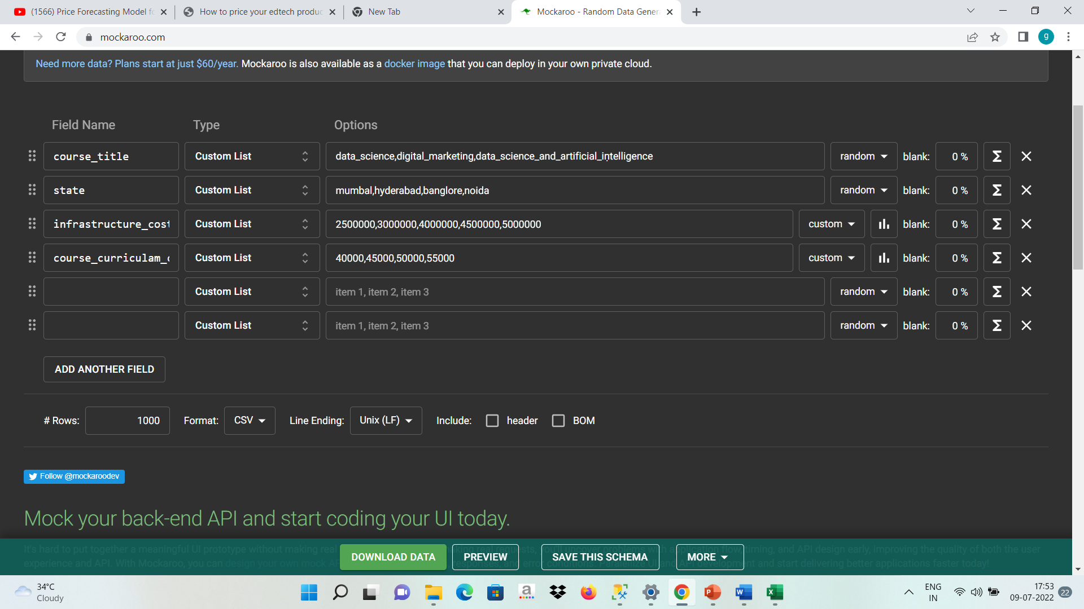
Data Dictionary

Slide 14
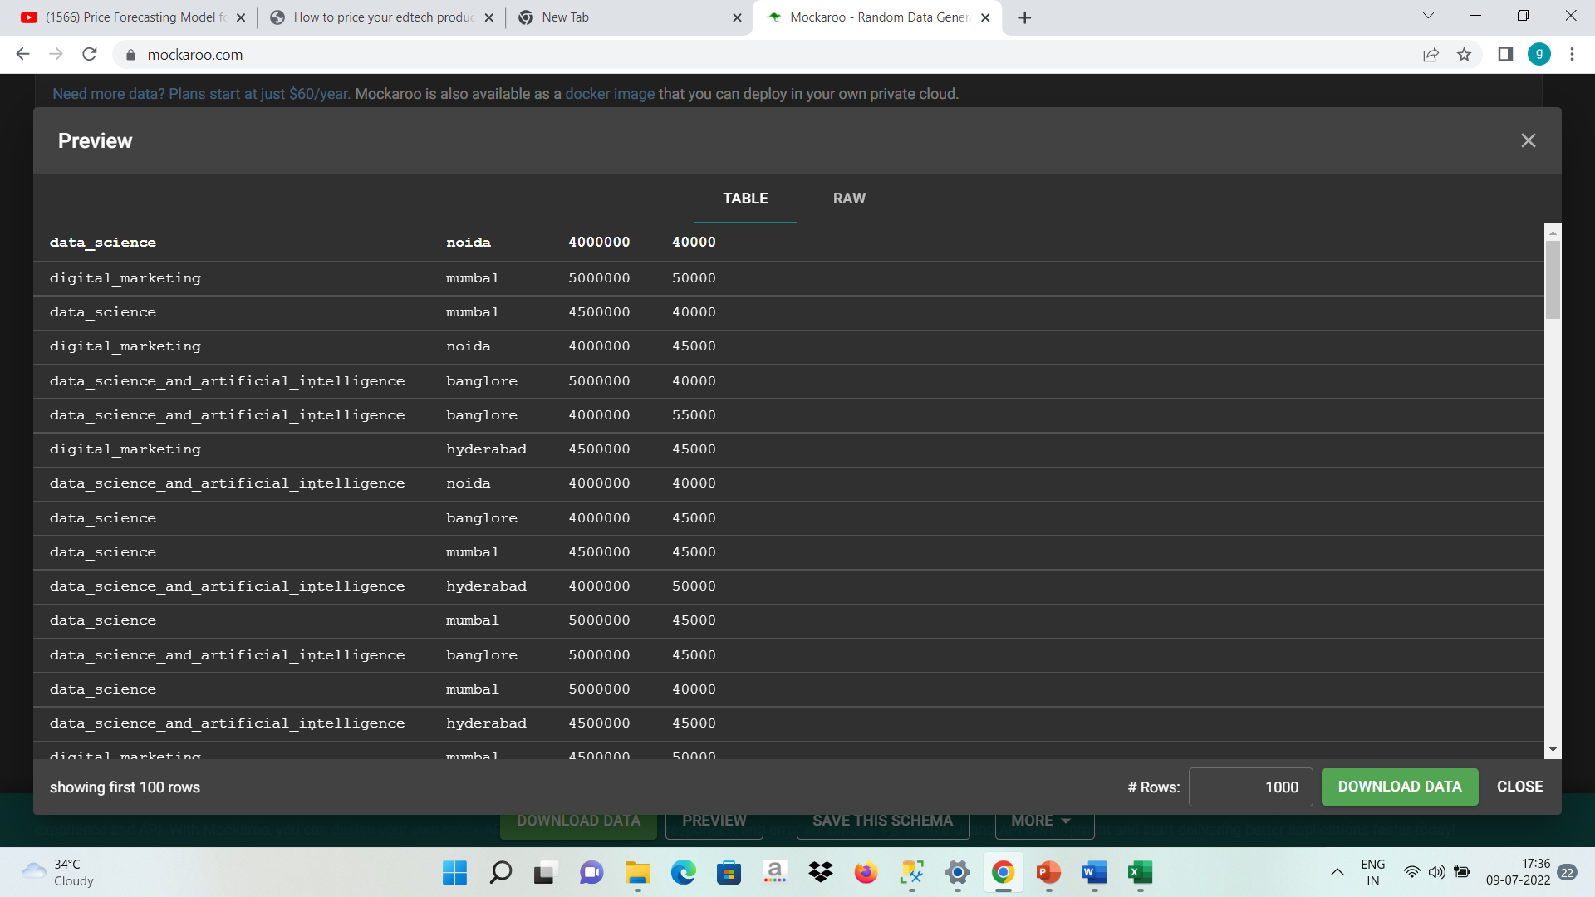
Data Dictionary
Notes:
Table change

Slide 15
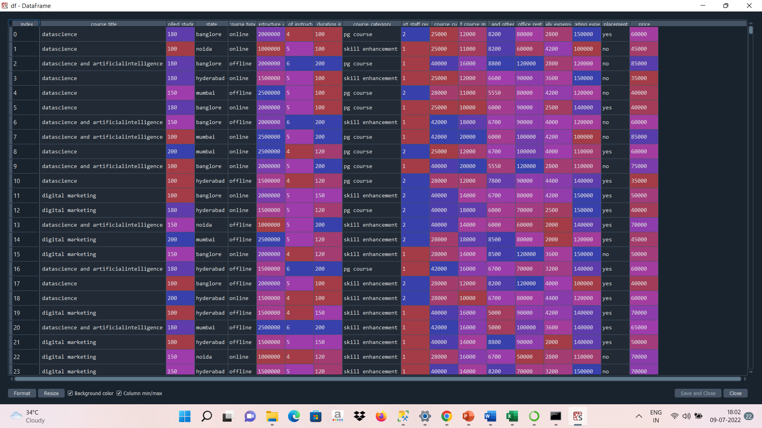
Data Dictionary

Slide 16
System Requirements
Generic Requirement
Data in the csv or excel format.
System Requirements
Memory: 8 GB
CPU: inter core i3 or above
OS: Windows 11(used by me)
PREPARE ENVIROMENT
Having a python 3.7 version or above because pycaret and pandas profiling is supported in python 3.7 version or above.
Having a github repository.
Having an account on the heroku for deployment.
Knowledge of regression model building.

Slide 17




Exploratory Data Analysis [EDA]
PACKAGES AND LIBRARIES USED FOR EDA

Slide 18
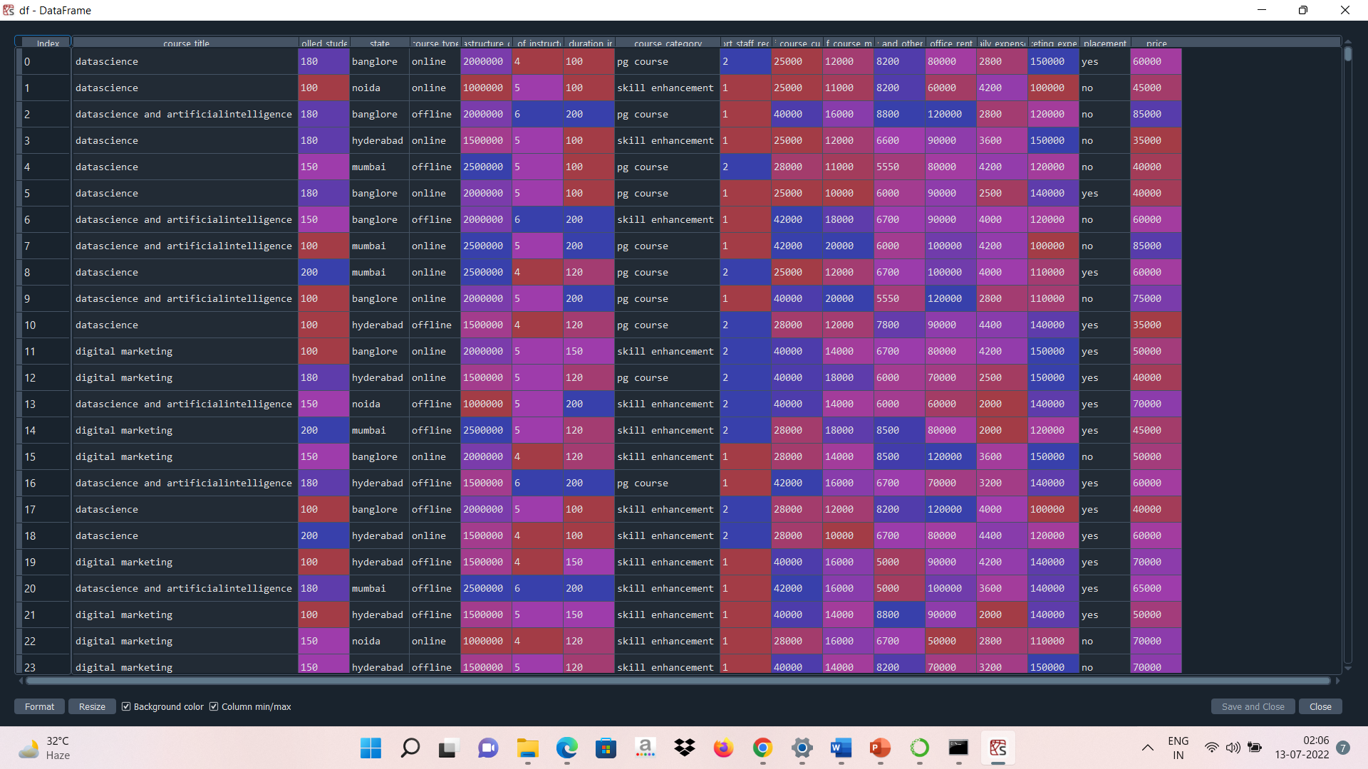
Exploratory Data Analysis [EDA]
Here as we can see in the dataset there is features like course_category,course_type,placements and course which has string. So in order to convert those features in the numerical format we have used dummies creation and one hot encoding.
Notes:
EDA is used for seeing what the data can tell us before the modeling task.
Change

Slide 19
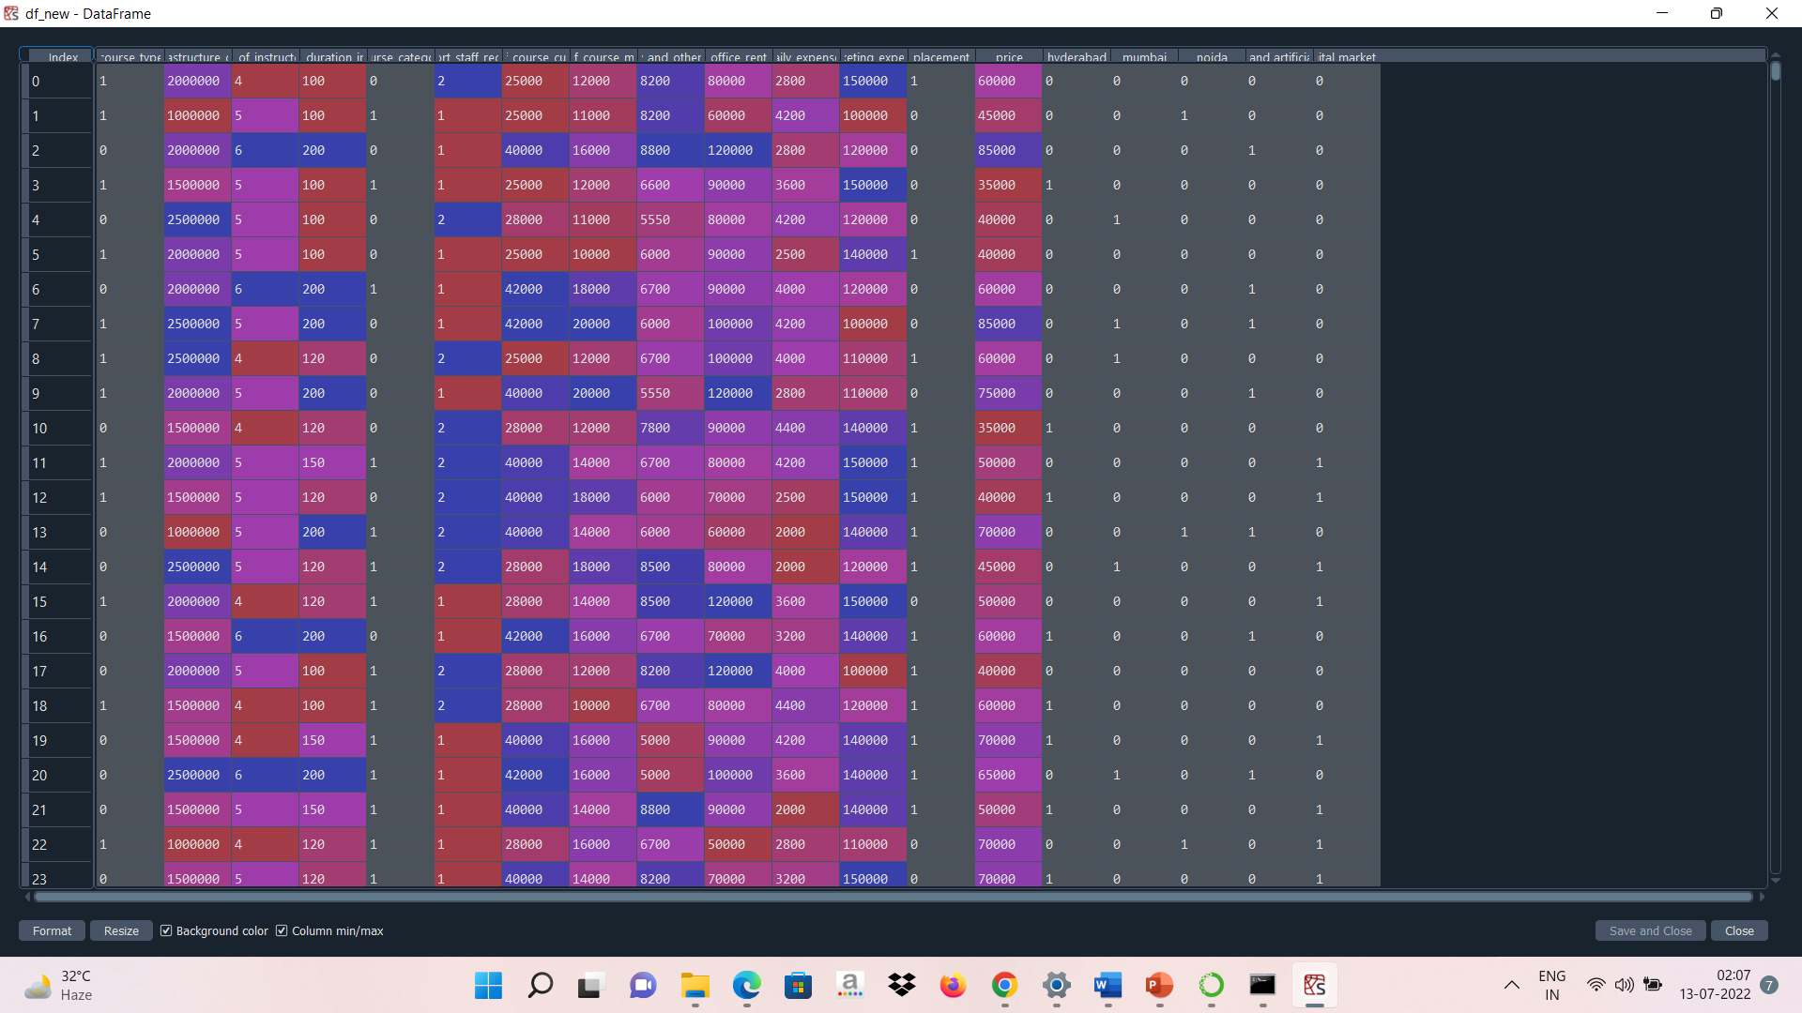
EDA Description
Transformed data

Slide 20
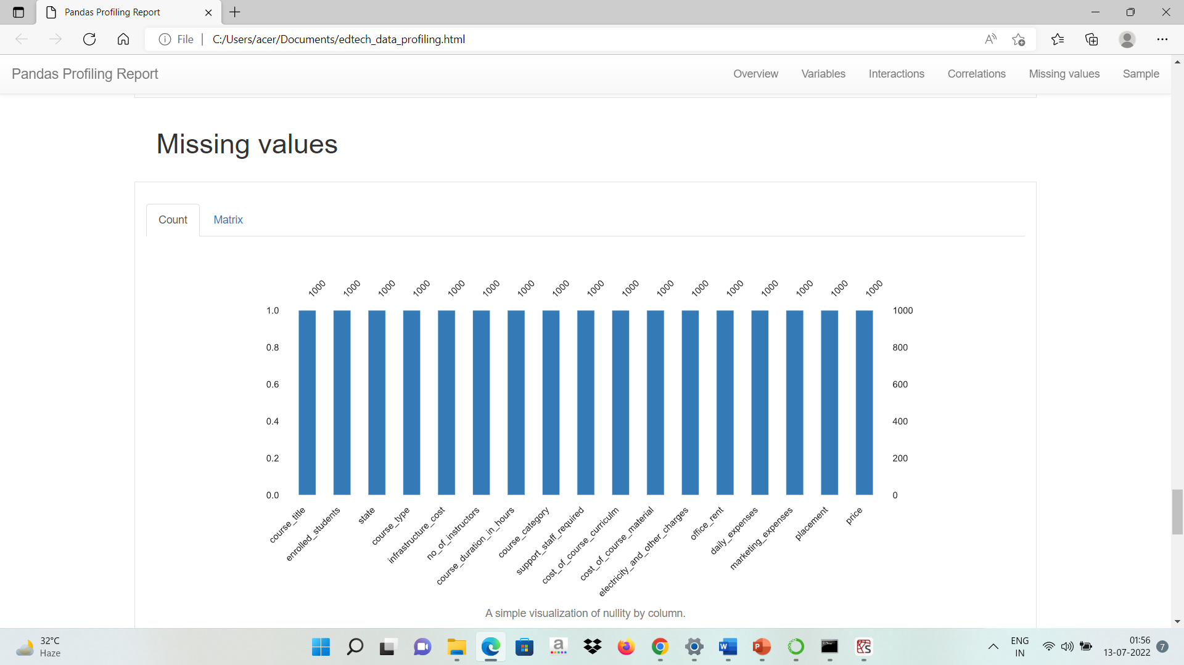
Missing Values Observation
As the dataset is created and customized manually so there is no missing values in the data set.

Slide 21

Data Visualization
Notes:
Keep observations

Slide 22
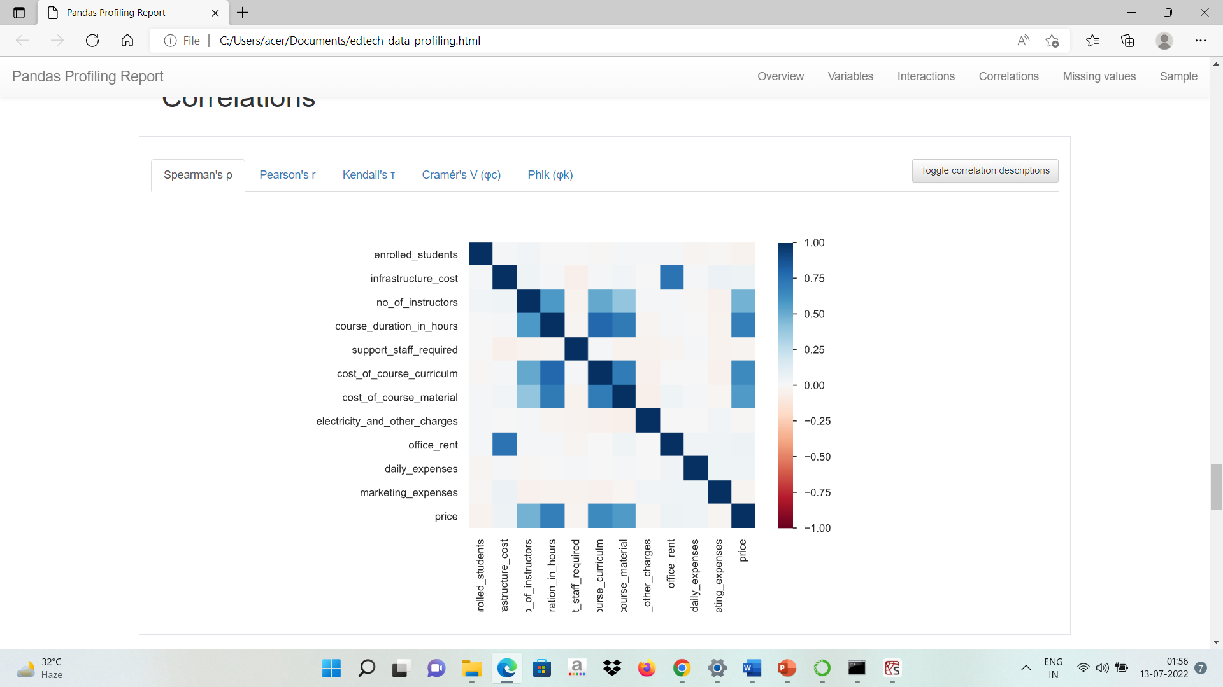
Data Visualization
Correlation matrix represented through heatmap.
price 1.000000
datascience and artificialintelligence 0.737156
course_duration_in_hours 0.705013
cost_of_course_curriculm 0.618518
cost_of_course_material 0.546142
no_of_instructors 0.498515
mumbai 0.063995
daily_expenses 0.051877
infrastructure_cost 0.044937
office_rent 0.043235
course_type 0.031752
noida 0.000488
course_category -0.004897
electricity_and_other_charges -0.008691
marketing_expenses -0.019690
support_staff_required -0.021215
hyderabad -0.053232
placement -0.056305
digital marketing -0.225837
Notes:
Add graphical

Slide 23
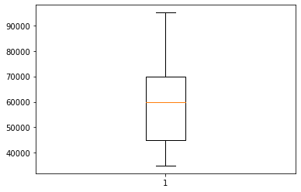
Data Visualization
Box plot for the dependent variable y.
No outliers detected.
Notes:
Piee

Slide 24
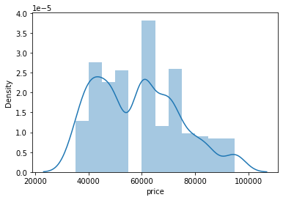
Data Visualization
Distribution plot for the dependent variable y.
Notes:
Piee

Slide 25
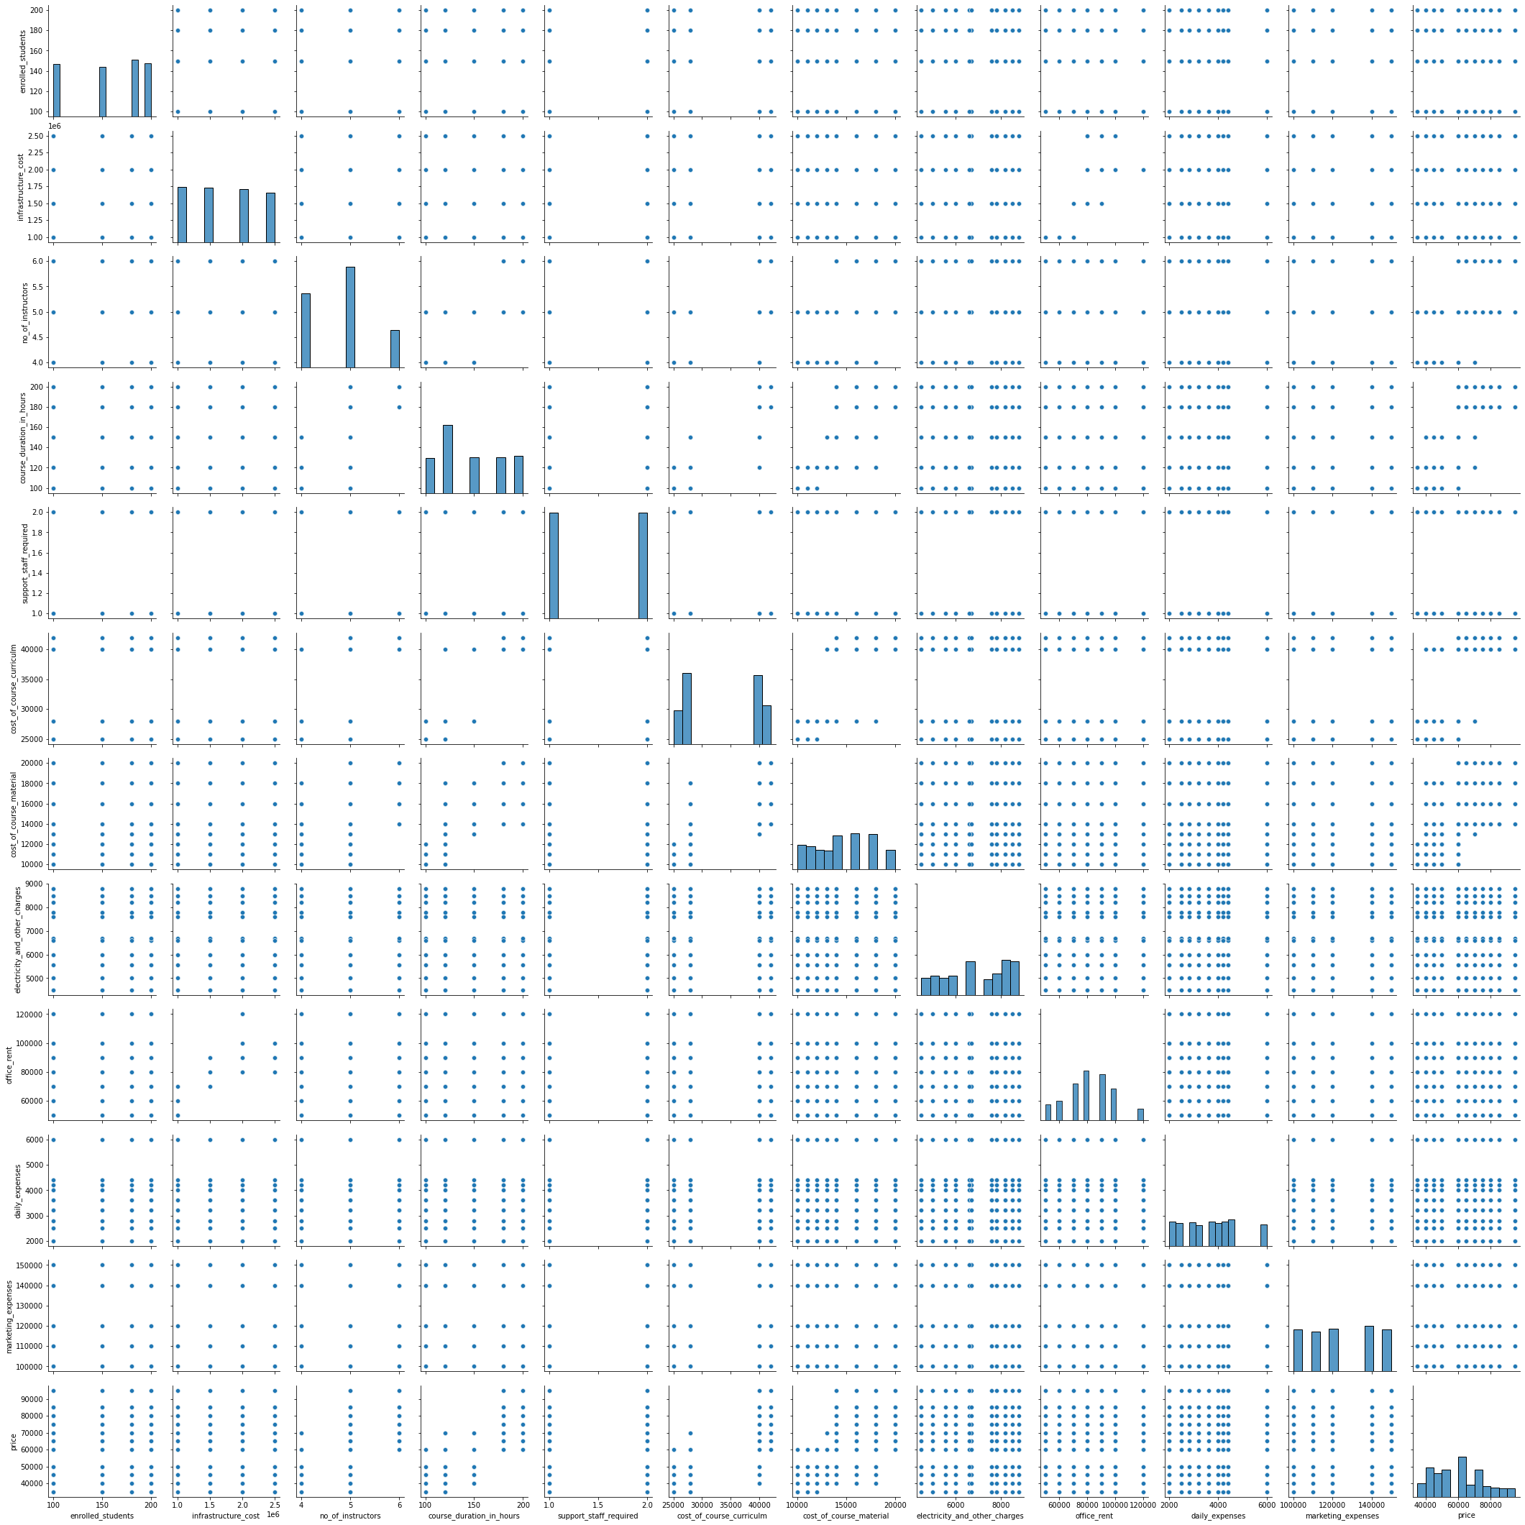
Data Visualization
PAIRPLOT
Notes:
Piee

Slide 26
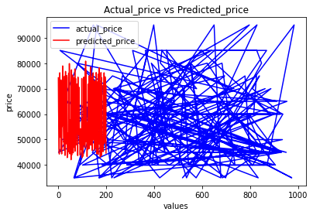
Data Visualization
Plotting the actual price vs the predicted with the help of the matplotlib.

Slide 27

Model Building
Notes:
classification is the task of predicting a discrete class label. Regression is the task of predicting a continuous quantity.
What is classification techniques in machine learning?
The Classification algorithm is a Supervised Learning technique that is used to identify the category of new observations on the basis of training data. In Classification, a program learns from the given dataset or observations and then classifies new observation into several classes or groups.
What is regression techniques in machine learning?
Regression is a technique for investigating the relationship between independent variables or features and a dependent variable or outcome. It's used as a method for predictive modeling in machine learning, in which an algorithm is used to predict continuous outcomes.

Slide 28
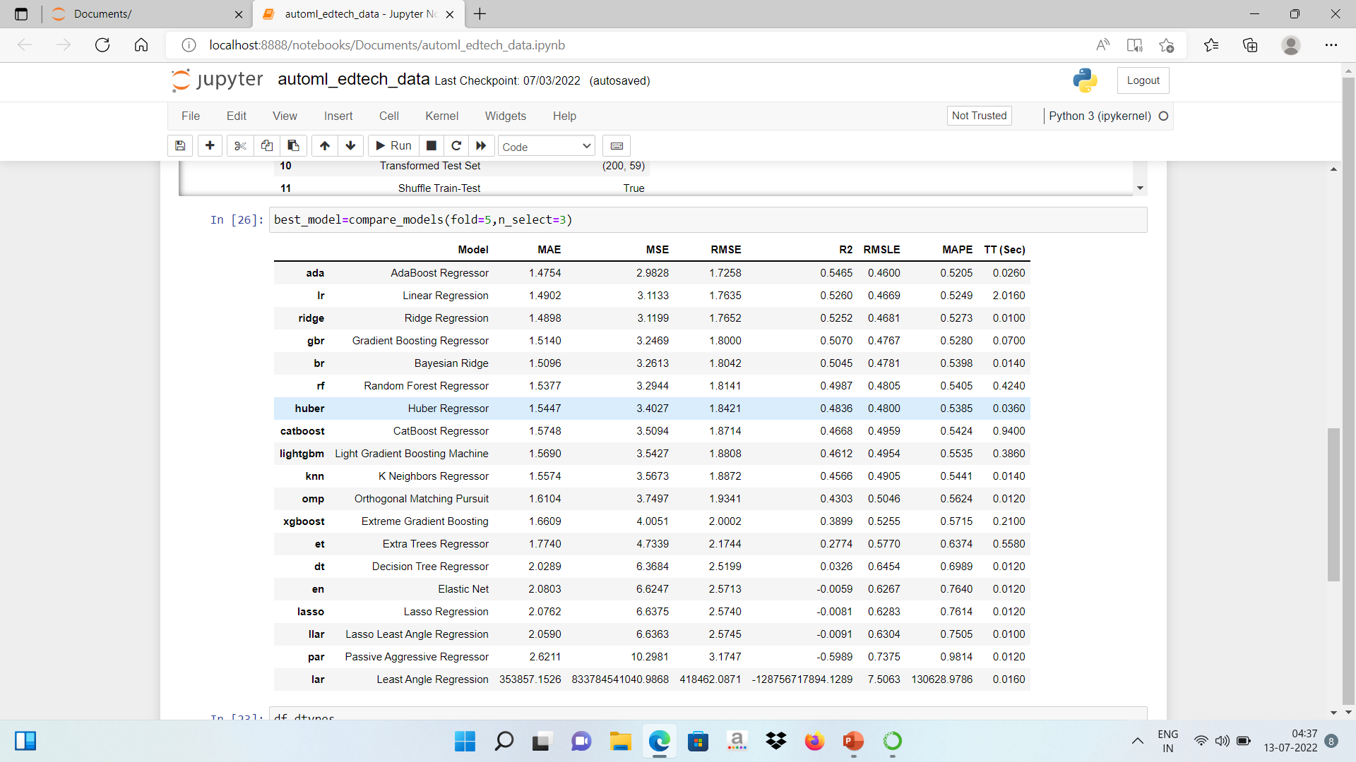
Model Building –
Applied automl with the help pycaret on the jupyter notebook and got the best accuracy and rmse value from aboboost regressor. So developed the model with the help of Adaboost Regressor.
Notes:
What is the role of regression in ML
Is regression supervised or unsupervised?

Slide 29
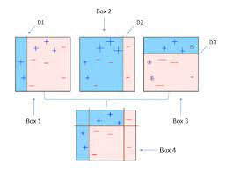
Model Building –
Understanding AdaBoost
Anyone starting to learn Boosting technique should start first with AdaBoost or Adaptive Boosting. Here I will try to explain it conceptually.
When nothing works, Boosting does. Nowadays many people use either XGBoost or LightGBM or CatBoost to win competitions at Kaggle or Hackathons. AdaBoost is the first stepping stone in the world of Boosting.
AdaBoost is one of the first boosting algorithms to be adapted in solving practices. Adaboost helps you combine multiple “weak classifiers” into a single “strong classifier”. Here are some (fun) facts about Adaboost!
→ The weak learners in AdaBoost are decision trees with a single split, called decision stumps.
→ AdaBoost works by putting more weight on difficult to classify instances and less on those already handled well.
→ AdaBoost algorithms can be used for both classification and regression problem.

Slide 30
Model Accuracy Comparison
Plotting the actual price vs the predicted with the help of the matplotlib
R2_SCORE= 0.5969246286987955
MEAN_SQUARED_LOG_ERROR=0.0331898147957893

Slide 31
Best Model –
Applied automl with the pycaret on the python notebook and got the best accuracy and rmse value from aboboost regressor. So developed the model with the help of Adaboost Regressor.
Notes:
Why Random Forest Regression is good?
A Random Forest Regression model is powerful and accurate. It usually performs great on many problems, including features with non-linear relationships
How is XGBoost different from random forest?
One of the most important differences between XG Boost and Random forest is that the XGBoost always gives more importance to functional space when reducing the cost of a model while Random Forest tries to give more preferences to hyperparameters to optimize the model..
n_estimators — the number of decision trees you will be running in the model

Slide 32
Model Deployment - Strategy
Model is being deployed on heroku by using the following steps.
Model is being created on spyder using python and adaboost regressor.
Then the model file is saved as the pickle file with the pkl extension.
An html file is to be created for the format of the app.
App.py file is created with the help of flask to get an url.
Check if the model is running into the url.
A procfile is created.
We have to also create a requirements.txt file where all the python libraries all written through which we have created the model.
Now put all file in your github repository.
Now create a app in heroku and there click on apply branch and deploy your model on heroku.

Slide 33
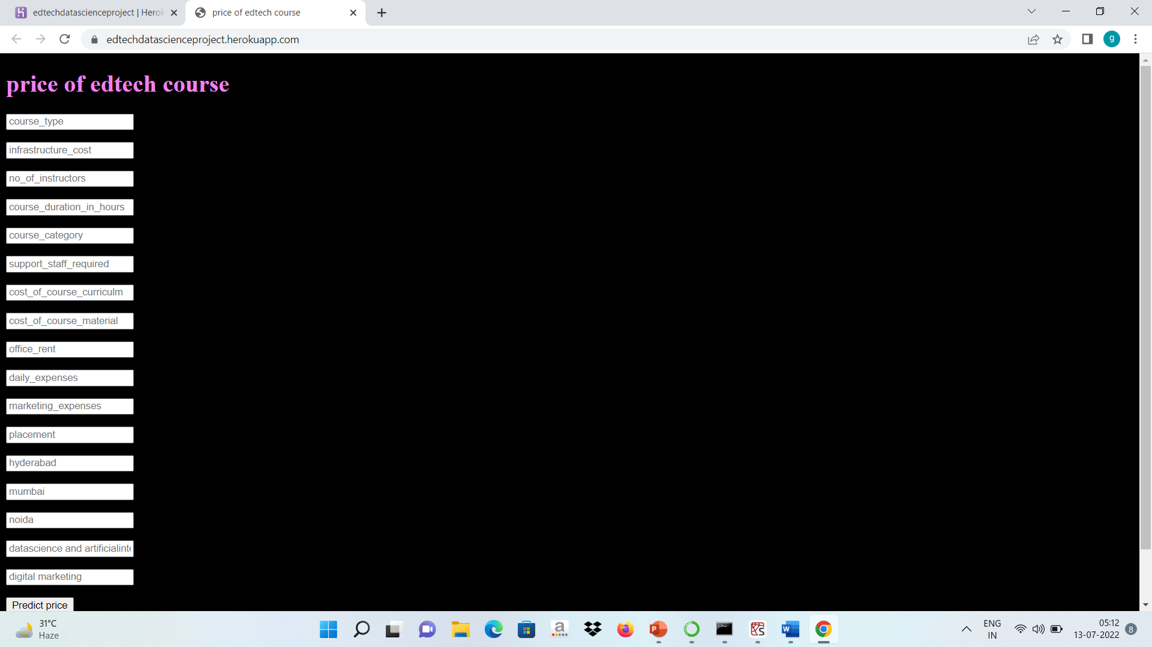
Screen shot of output

Slide 34
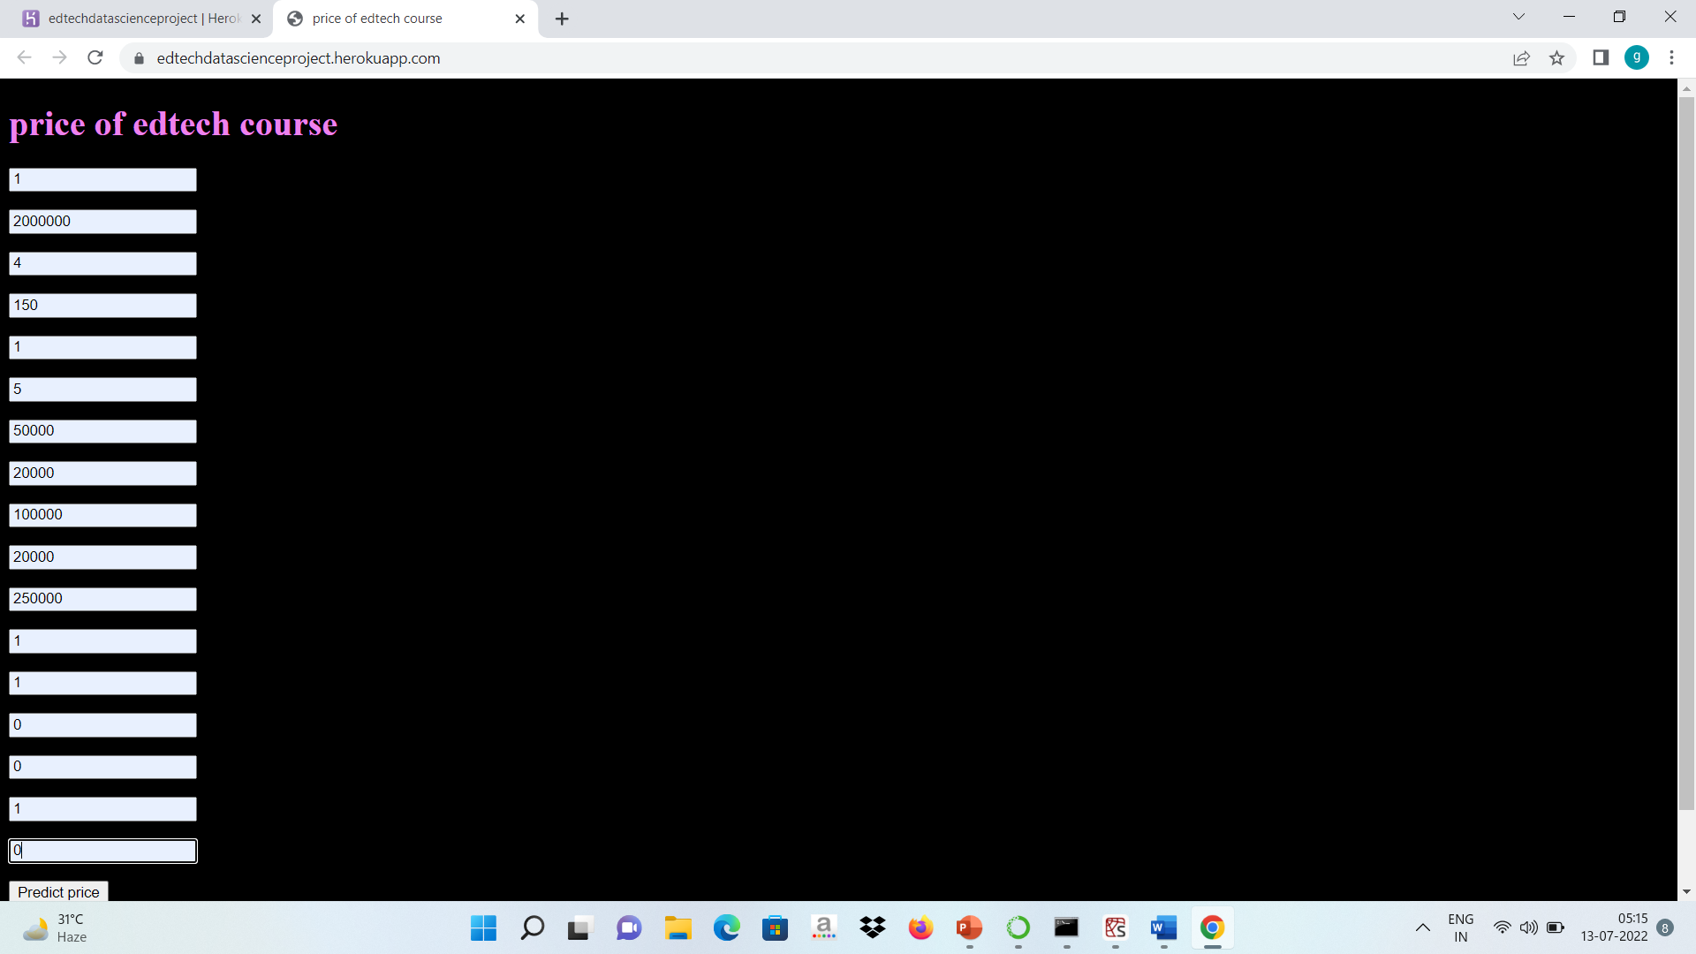
Screen shot of output

Slide 35
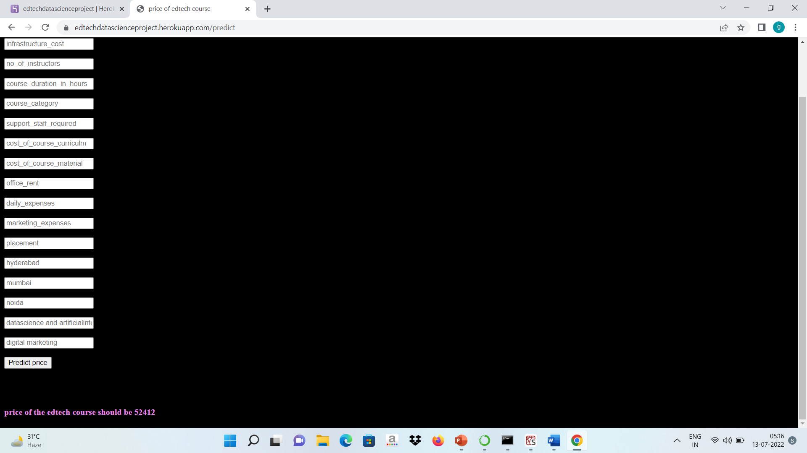
Screen shot of output

Slide 36
Challenges
The biggest challenge while developing a model for predicting the price of edtech course was the data collection and the customizing the dataset.
Feature selection was also the diffficult task as the selected features will directly have impact on the final prediction so the features selectioni should be done carefully.
Came to know about new features like automl and autoeda so working on that was also challenging task but it helped in the model selection and it has also developed more understanding about the data and machine learning algorithm.
I was doing deployment for the first time so I had to research about that and our project team mentors also helped us and recommended videos on deployment on aispry was also very helpful,

Slide 37
Future Scopes
While a Blume Ventures report said that the edtech market was close to $750 mn in 2020 and will hit $4 bn by 2025, a recent report by management consulting and market research firm Redseer puts that number at $5 billion by 2025.
So as we can see that from the report that edtech is the rapidly growing market and as the market is vast so the competetion will be also high so setting up the right price for the course is the most necessary thing for which our model is being developed.
The primary goal of our model is to predict the price of the edtech course which is yet to be launched.
It can be a reliable price on which you can launch your edtech course.
This model have a potential to be successfully implemented in the edtech industry for future price forecasting and prediction.

Slide 38

Queries ?

Slide 39


